Slide 1

DISCLAIMER
The information in this presentation is provided to you by PT. AXAR Technology Raya, solely for informational purposes and does not constitute an offer to buy, sell or issue, or a solicitation of an offer to sell, buy or acquire any securities of the Company in any jurisdiction or an inducement to enter into investment activity, nor may it or any part of it form the basis of or be relied on in connection with any contract or commitment whatsoever. No representations or warranties, express or implied, are made by the Company, any underwriters, any of their respective affiliates, directors, officers, employees, advisors or representatives with respect to, and no reliance should be placed, on the accuracy, fairness or completeness of the information presented or contained in this presentation. By viewing this presentation, you agree that none of the Company, any underwriters, nor any of their respective affiliates, directors, officers, employees, advisors or representatives accepts any responsibility or liability whatsoever for any loss howsoever arising from any information presented or contained in or derived from or omitted from this presentation. The information presented or contained in this presentation was obtained from various sources, including certain third parties, and has not been independently verified, and its accuracy is not guaranteed.
This presentation does not contain all relevant information relating to the Company or its securities, particularly with respect to the risks and special considerations involved with an investment in the securities of the Company. These materials are not an offer of securities for sale. Any public offering will be made by means of a prospectus that may be obtained from the issuer and that will contain detailed information about the company and management, as well as financial statements. This presentation speaks as of its date and the information presented or contained in this presentation is subject to change without notice or update.
This presentation contains statements that constitute forward-looking statements. These statements include descriptions regarding the intent, belief or current expectations of the Company or its officers about the future. These statements can be recognized by the use of words such as “expects,” “plans,” “will,” “estimates,” “projects,” “intends,” or words of similar meaning. Such forward-looking statements are not guarantees of future performance and involve risks and uncertainties, and actual results may differ from those in the forward-looking statements as a result of various factors and assumptions, many of which are beyond the Company’s control. The Company or any of its affiliates, advisors, representatives or underwriters has no obligation and does not undertake to revise forward-looking statements to reflect future events or circumstances.
THE INFORMATION CONTAINED IN THIS DOCUMENT IS HIGHLY CONFIDENTIAL AND MAY NOT BE FORWARDED, PUBLISHED OR DISTRIBUTED, DIRECTLY OR INDIRECTLY, TO ANY OTHER PERSON (WHETHER WITHIN OR OUTSIDE YOUR ORGANIZATION/FIRM) FOR ANY PURPOSE AND MAY NOT BE REPRODUCED IN ANY MANNER WHATSOEVER. ANY FORWARDING, PUBLICATION, DISTRIBUTION OR REPRODUCTION OF THIS DOCUMENT IN WHOLE OR IN PART IS UNAUTHORIZED.
MOBILE
DEVELOPMENT
DAY 1

Slide 2
OBJECTIVES
Asynchronous programming
Notes:
Save Time....:
The Platform will house/aggregate thousands of DIRECT SUPPLIERS. Buyer members are now abled to easily Pick whats best suitable for them.
Discover...:
Suppliers need to be a registered and verified members. There will be features such as ratings and certifications to boost further.
Grow Business:
Members akan di-empowered dengan sebuah tool digital yang yang tadinya menyerang industri, malah justru membuat mereka bisa menjadi lebih kompetitif di era digital.

Slide 3
Asynchronous Programming
Operasi asinkron memungkinkan program Anda selesai bekerja sambil menunggu operasi lain selesai. Berikut beberapa operasi asinkron yang umum:
Mengambil data melalui jaringan.
Menulis ke database.
Membaca data dari file.
Untuk melakukan operasi asinkron di Dart, Anda dapat menggunakan kelas Future dan kata kunci async dan await.
Notes:
Save Time....:
The Platform will house/aggregate thousands of DIRECT SUPPLIERS. Buyer members are now abled to easily Pick whats best suitable for them.
Discover...:
Suppliers need to be a registered and verified members. There will be features such as ratings and certifications to boost further.
Grow Business:
Members akan di-empowered dengan sebuah tool digital yang yang tadinya menyerang industri, malah justru membuat mereka bisa menjadi lebih kompetitif di era digital.

Slide 4
Asynchronous Programming
future (huruf kecil "f") adalah turunan dari kelas Future (huruf besar "F"). Masa depan mewakili hasil operasi asynchronous , dan dapat memiliki dua status: uncompleted dan completed.
Uncompleted
Saat Anda memanggil fungsi asynchronous, ini mengembalikan masa depan yang belum selesai. Masa depan itu menunggu hingga operasi asynchronous dari fungsi tersebut selesai atau memunculkan kesalahan
Completed
Jika operasi asynchronous berhasil, masa depan selesai dengan sebuah nilai. Jika tidak, itu akan selesai dengan kesalahan.
Notes:
Save Time....:
The Platform will house/aggregate thousands of DIRECT SUPPLIERS. Buyer members are now abled to easily Pick whats best suitable for them.
Discover...:
Suppliers need to be a registered and verified members. There will be features such as ratings and certifications to boost further.
Grow Business:
Members akan di-empowered dengan sebuah tool digital yang yang tadinya menyerang industri, malah justru membuat mereka bisa menjadi lebih kompetitif di era digital.

Slide 5
Asynchronous Programming
Completing with a value
tipe Future<T> dilengkapi dengan nilai tipe T. Misalnya, masa depan dengan tipe <String> Future menghasilkan nilai string. Jika masa depan tidak menghasilkan nilai yang dapat digunakan, maka jenis masa depan adalah <void> Masa Depan.
Completing with an error
Jika operasi asynchronous yang dilakukan oleh fungsi gagal karena alasan apa pun, masa depan akan dilengkapi dengan kesalahan.
Notes:
Save Time....:
The Platform will house/aggregate thousands of DIRECT SUPPLIERS. Buyer members are now abled to easily Pick whats best suitable for them.
Discover...:
Suppliers need to be a registered and verified members. There will be features such as ratings and certifications to boost further.
Grow Business:
Members akan di-empowered dengan sebuah tool digital yang yang tadinya menyerang industri, malah justru membuat mereka bisa menjadi lebih kompetitif di era digital.

Slide 6
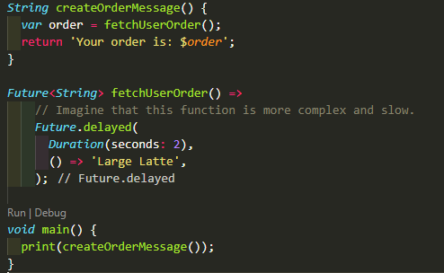
Asynchronous Programming
contoh completing with a value
Notes:
Save Time....:
The Platform will house/aggregate thousands of DIRECT SUPPLIERS. Buyer members are now abled to easily Pick whats best suitable for them.
Discover...:
Suppliers need to be a registered and verified members. There will be features such as ratings and certifications to boost further.
Grow Business:
Members akan di-empowered dengan sebuah tool digital yang yang tadinya menyerang industri, malah justru membuat mereka bisa menjadi lebih kompetitif di era digital.

Slide 7
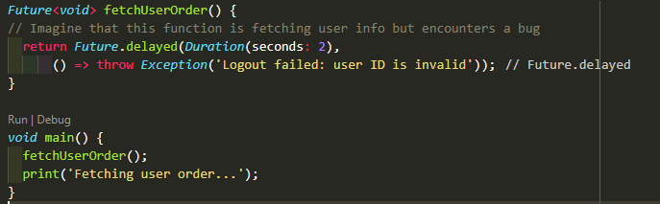
Asynchronous Programming
contoh completing with an error
Notes:
Save Time....:
The Platform will house/aggregate thousands of DIRECT SUPPLIERS. Buyer members are now abled to easily Pick whats best suitable for them.
Discover...:
Suppliers need to be a registered and verified members. There will be features such as ratings and certifications to boost further.
Grow Business:
Members akan di-empowered dengan sebuah tool digital yang yang tadinya menyerang industri, malah justru membuat mereka bisa menjadi lebih kompetitif di era digital.

Slide 8
Asynchronous Programming : async dan await
Kata kunci async dan await menyediakan cara deklaratif untuk mendefinisikan fungsi asynchronous dan menggunakan hasilnya. Ingat dua pedoman dasar ini saat menggunakan async dan await:
Untuk menentukan fungsi asynchronous , tambahkan async sebelum badan fungsi:
Kata kunci await hanya berfungsi dalam fungsi async.
Berikut ini contoh yang mengonversi main () dari fungsi sinkron menjadi fungsi asinkron.
syntax :
Future<void> nama_methods() async { ··· }
await nama_methods();
Notes:
Save Time....:
The Platform will house/aggregate thousands of DIRECT SUPPLIERS. Buyer members are now abled to easily Pick whats best suitable for them.
Discover...:
Suppliers need to be a registered and verified members. There will be features such as ratings and certifications to boost further.
Grow Business:
Members akan di-empowered dengan sebuah tool digital yang yang tadinya menyerang industri, malah justru membuat mereka bisa menjadi lebih kompetitif di era digital.

Slide 9
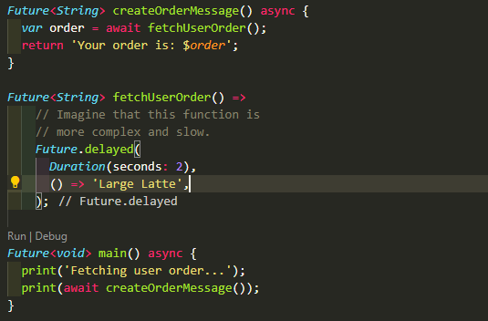

Asynchronous Programming
Contoh :
Pada program disamping dapat dilihat bahwa createOrderMessagge() akan dijalankan setelah menunggu selama 2 detik
Notes:
Save Time....:
The Platform will house/aggregate thousands of DIRECT SUPPLIERS. Buyer members are now abled to easily Pick whats best suitable for them.
Discover...:
Suppliers need to be a registered and verified members. There will be features such as ratings and certifications to boost further.
Grow Business:
Members akan di-empowered dengan sebuah tool digital yang yang tadinya menyerang industri, malah justru membuat mereka bisa menjadi lebih kompetitif di era digital.

Slide 10
DISCLAIMER
The information in this presentation is provided to you by PT. AXAR Technology Raya, solely for informational purposes and does not constitute an offer to buy, sell or issue, or a solicitation of an offer to sell, buy or acquire any securities of the Company in any jurisdiction or an inducement to enter into investment activity, nor may it or any part of it form the basis of or be relied on in connection with any contract or commitment whatsoever. No representations or warranties, express or implied, are made by the Company, any underwriters, any of their respective affiliates, directors, officers, employees, advisors or representatives with respect to, and no reliance should be placed, on the accuracy, fairness or completeness of the information presented or contained in this presentation. By viewing this presentation, you agree that none of the Company, any underwriters, nor any of their respective affiliates, directors, officers, employees, advisors or representatives accepts any responsibility or liability whatsoever for any loss howsoever arising from any information presented or contained in or derived from or omitted from this presentation. The information presented or contained in this presentation was obtained from various sources, including certain third parties, and has not been independently verified, and its accuracy is not guaranteed.
This presentation does not contain all relevant information relating to the Company or its securities, particularly with respect to the risks and special considerations involved with an investment in the securities of the Company. These materials are not an offer of securities for sale. Any public offering will be made by means of a prospectus that may be obtained from the issuer and that will contain detailed information about the company and management, as well as financial statements. This presentation speaks as of its date and the information presented or contained in this presentation is subject to change without notice or update.
This presentation contains statements that constitute forward-looking statements. These statements include descriptions regarding the intent, belief or current expectations of the Company or its officers about the future. These statements can be recognized by the use of words such as “expects,” “plans,” “will,” “estimates,” “projects,” “intends,” or words of similar meaning. Such forward-looking statements are not guarantees of future performance and involve risks and uncertainties, and actual results may differ from those in the forward-looking statements as a result of various factors and assumptions, many of which are beyond the Company’s control. The Company or any of its affiliates, advisors, representatives or underwriters has no obligation and does not undertake to revise forward-looking statements to reflect future events or circumstances.
THE INFORMATION CONTAINED IN THIS DOCUMENT IS HIGHLY CONFIDENTIAL AND MAY NOT BE FORWARDED, PUBLISHED OR DISTRIBUTED, DIRECTLY OR INDIRECTLY, TO ANY OTHER PERSON (WHETHER WITHIN OR OUTSIDE YOUR ORGANIZATION/FIRM) FOR ANY PURPOSE AND MAY NOT BE REPRODUCED IN ANY MANNER WHATSOEVER. ANY FORWARDING, PUBLICATION, DISTRIBUTION OR REPRODUCTION OF THIS DOCUMENT IN WHOLE OR IN PART IS UNAUTHORIZED.
THANK YOU

